Slide 1

Projection
CS 418: Interactive Computer Graphics
UNIVERSITY OF ILLINOIS AT URBANA-CHAMPAIGN
Eric Shaffer

Slide 2
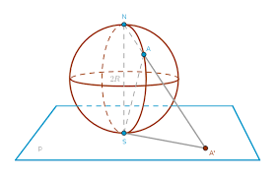
Projections
In computer graphics, eventually we need to move from 3D space to 2D space
More accurately: from 4D homogeneous coordinates to 3D homogeneous coordinates
A projection is a transformation that maps from a high-dimensional space into a lower-dimensional space.
We will look at some common projections…and then we will discuss projection within WebGL

Slide 3
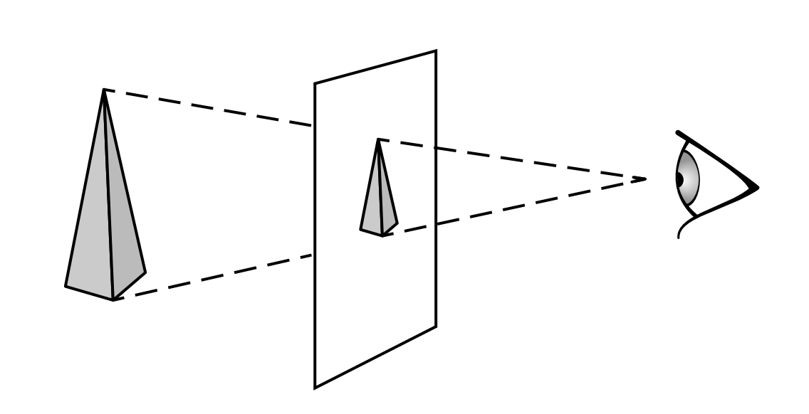
Perspective Projection

Slide 4
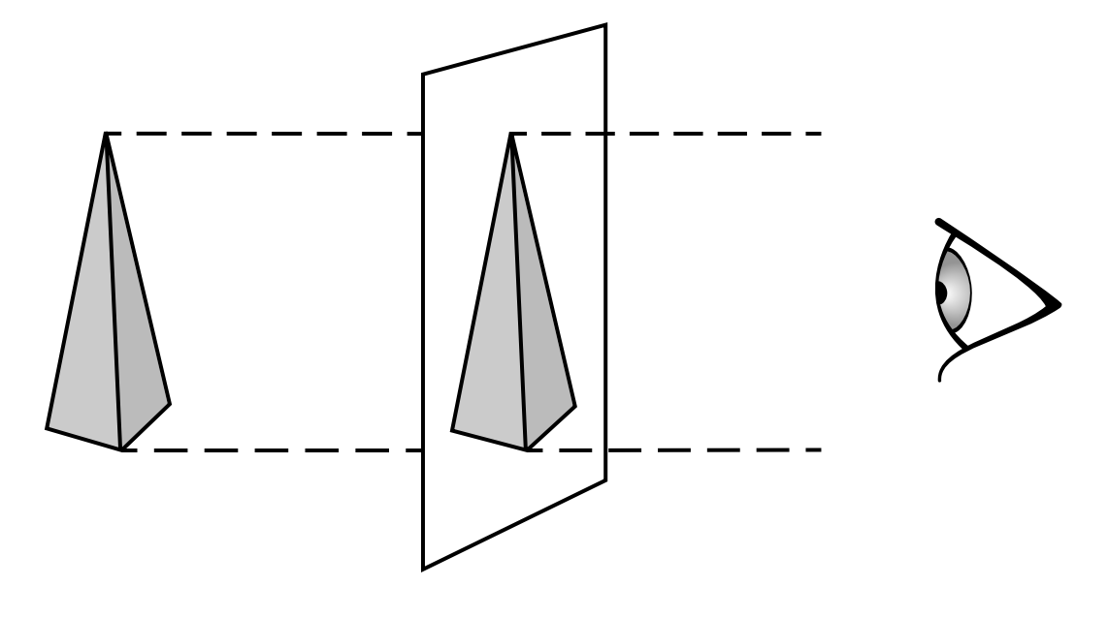
Orthographic Projection

Slide 5
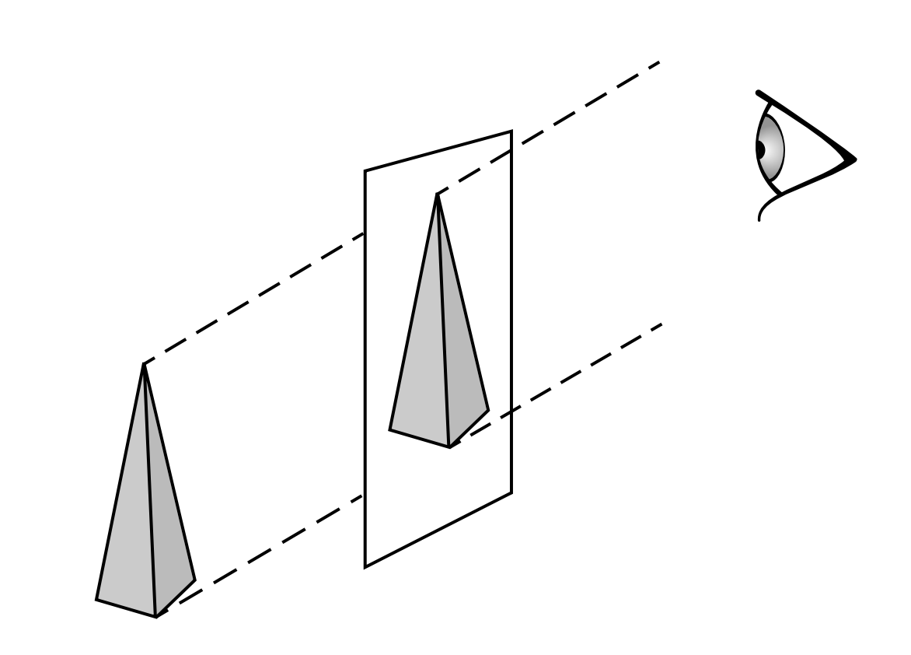
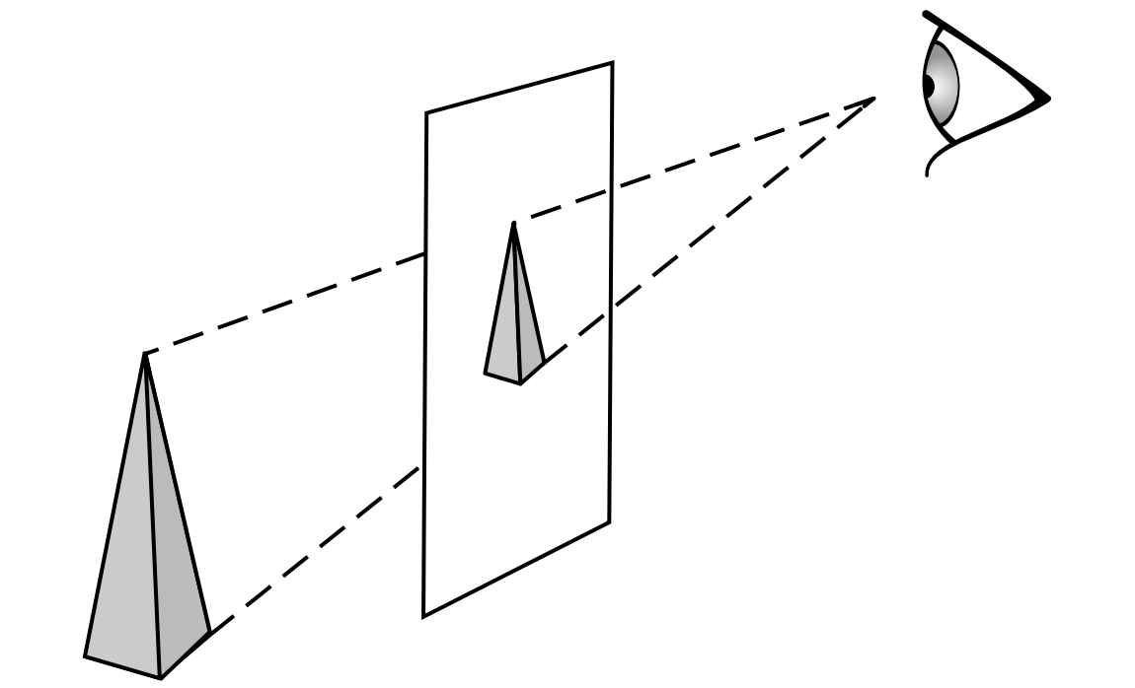
Oblique Projections
Oblique parallel projection Oblique perspective projection
Linear projections can be categorized
By whether the projectors are parallel
By whether the projectors are orthogonal to the view plane
We will not use oblique projections in this course…..

Slide 6
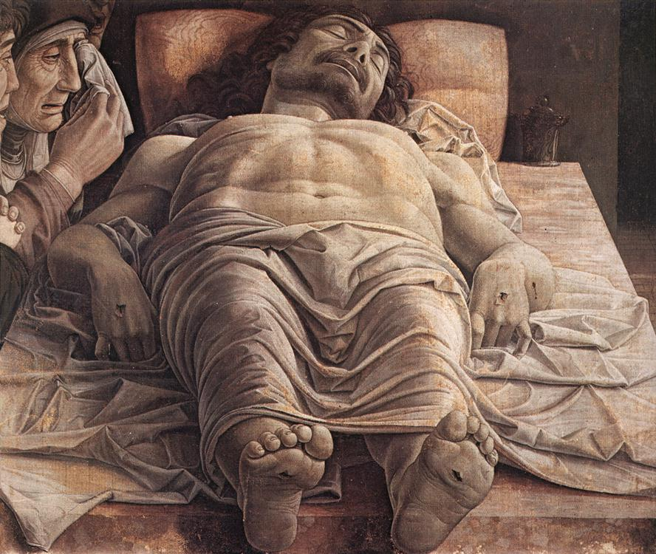
Definition to Know: Foreshortening
Foreshortening is the
visual effect
or optical illusion
that causes an
object or distance to
appear shorter than it
actually is.
...projections
squash
receding surfaces
Can foreshortening happen in orthographic projection?
Andrea Mantegna
The Lamentation over the Dead Christ

Slide 7
Clip Space View Volume
Before looking at projections in more detail…
…let’s experimentally determine what the default view and view volume are.
So, if we don’t do any transformations…where are we and what direction are we looking?
Take a look at https://developer.mozilla.org/en-US/docs/Web/API/WebGL_API/WebGL_model_view_projection http://jsfiddle.net/2x03hdc8/
It is a simple WebGL program that lets you draw rectangles
No transformations
By altering the rectangle coordinates, you can figure out the view….

Slide 8
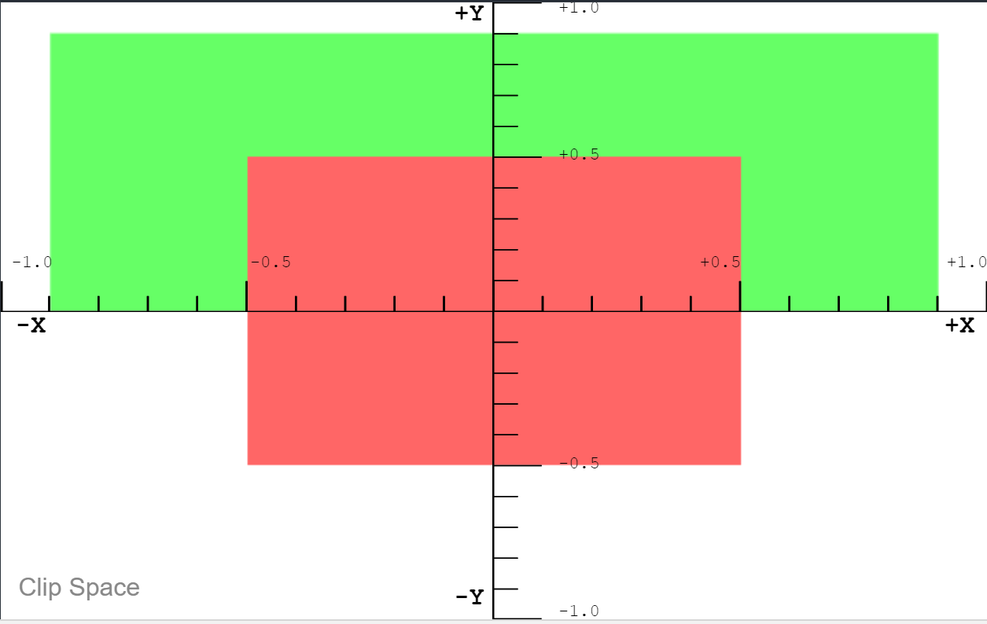
Clip Space View
Red rectangle has z=0
Green has z=0.5
What direction are we looking?

Slide 9
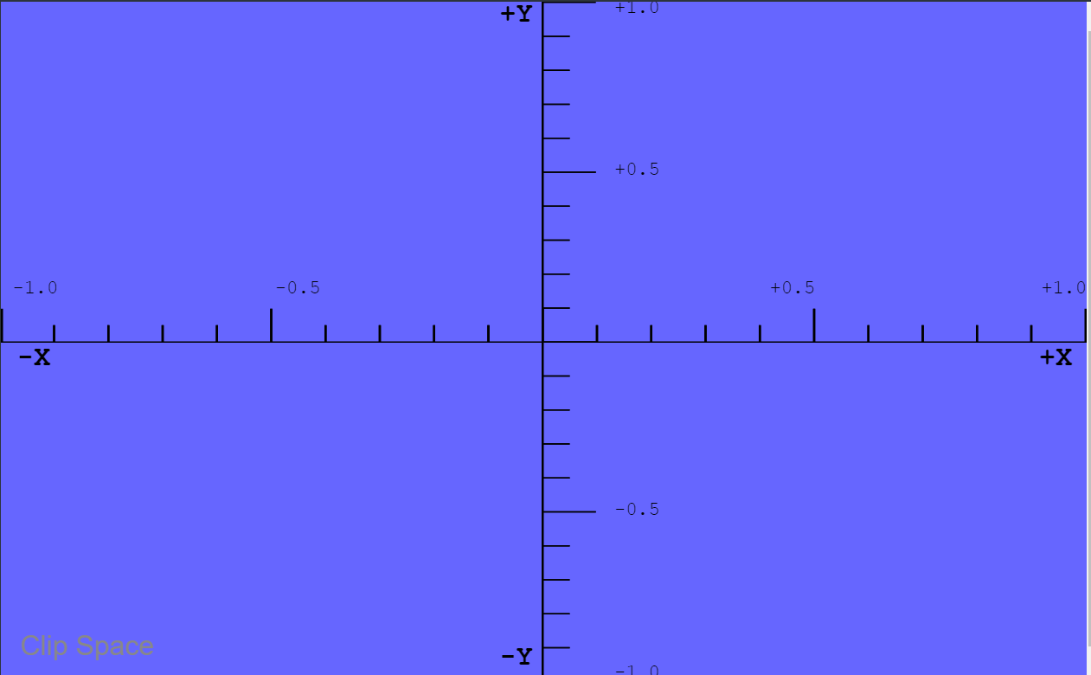
Clip Space View
We add a blue rectangle It’s at z=-1
Where is the near clipping plane?

Slide 10
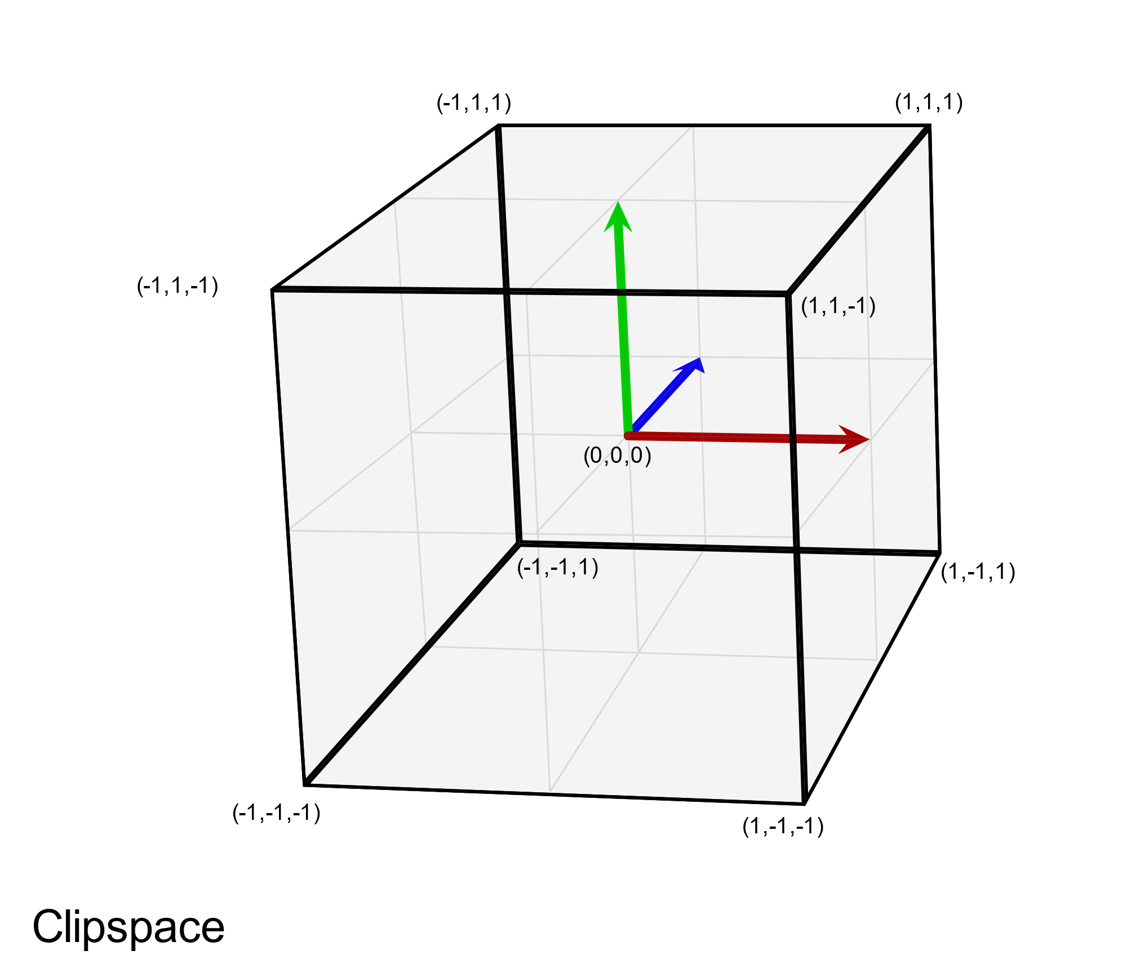
Clip Space View and View Volume
View is looking down Z+
Eyepoint is effectively at (0,0,-1)
This is a left-handed coordinate system
This is a little-known fact…. People often learn to use WebGL without ever learning this.
We’ll see why in a few slides

Slide 11
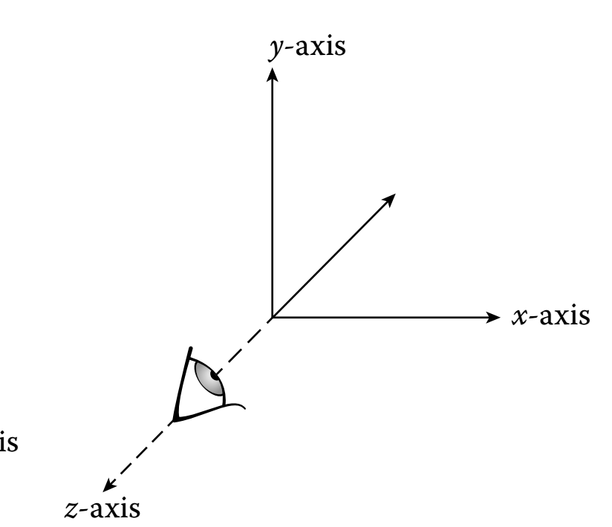
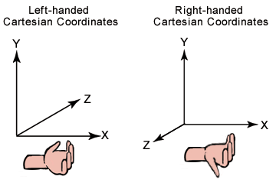
WebGL Style View
WebGL/OpenGL convention is to assume a right-handed world coordinate system
The ortho matrix is used to flip this coordinate system by scaling Z by -1
It then matches WebGL clip space

Slide 12
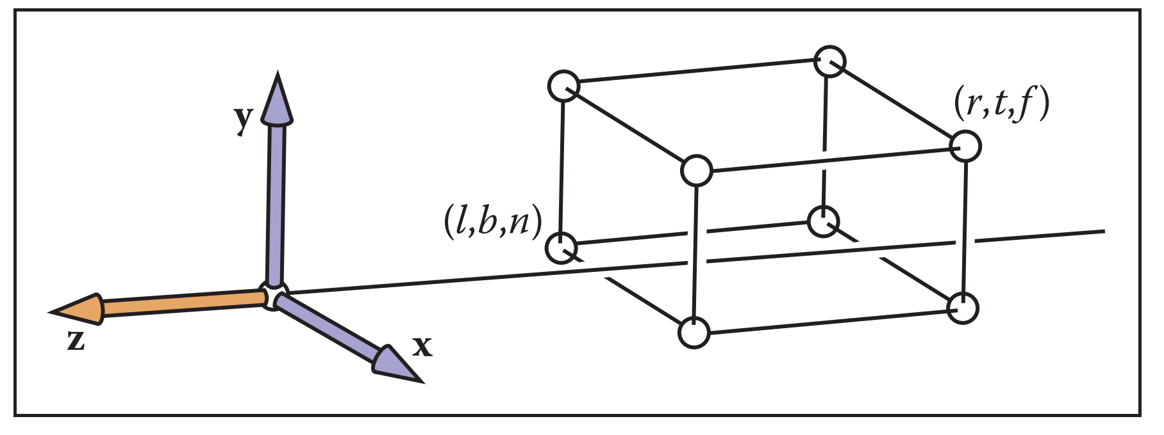
More WebGL Secrets
Model Coords
Model Xform
World Coords
Viewing Xform
Viewing Coords
Perspective Distortion
Still Clip Coords.
Clipping
Clip Coords.
Homogeneous Divide
Window
Coordinates
Window
to
Viewport
Viewport
Coordinates
WebGL only performs an orthogonal projection
Everything is projected to the z=0 plane in the normalized view volume
But you can distort your geometry to achieve a perspective projection
The projection occurs when the geometry is in clip space (NDC)
Even then, depth information is kept around to do hidden surface removal
Depth information means transformed z coordinates

Slide 13
Why Projection Matrices?
After the view transformation the situation is:
The eye is at (0,0,0)
The eye is looking down the –Z axis (in WebGL)
We define a view volume in view coordinates
This determines what will be visible when we render
A projection matrix maps our view volume into the canonical view volume

Slide 14
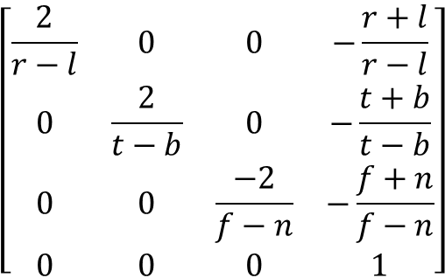
Orthographic Projection
View Volume
(left,top,-near)
y
Foreshortens
No change in size by depth
Classic Orthographic Projection matrix simply zeros the z- coordinate
mat4.ortho(out,left,right,bottom,top,near,far)
-z
z
x
(right,bottom,-far)
Viewing Coordinates
Ortho
Clip Coordinates
$$\left[\begin{matrix}\frac{2}{r−l} & 0 & 0 & −\frac{r+l}{r−l} \\ 0 & \frac{2}{t−b} & 0 & −\frac{t+b}{t−b} \\ 0 & 0 & \frac{−2}{f−n} & −\frac{f+n}{f−n} \\ 0 & 0 & 0 & 1\end{matrix}\right]$$
Does the ortho matrix perform a projection?

Slide 15
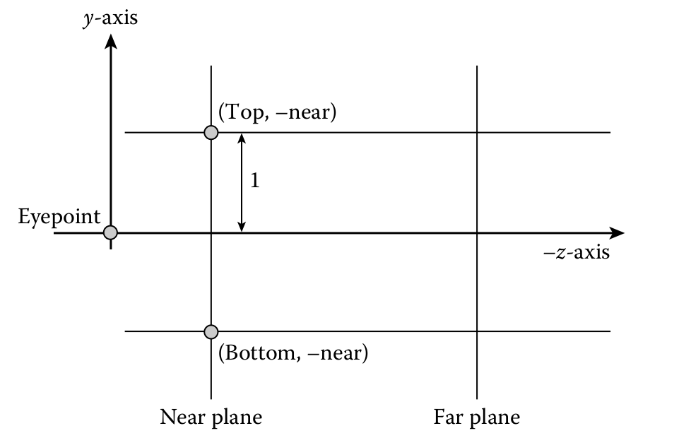
GLMatrix ortho matrix
ortho(left,right,bottom,top,near,far)
near and far are distances down the –z axis from origin
l,r,b,t are coordinates of the bounding planes
what does the matrix do?

Slide 16
GLMatrix ortho matrix
ortho(left,right,bottom,top,near,far)
Imagine the eye is at (0,0,0) We look down the –z axis
The view volume is: [left, right] =[-1, 1] [bottom, top]=[-1, 1]
near =0
far =2
What does the matrix look like?

Slide 17
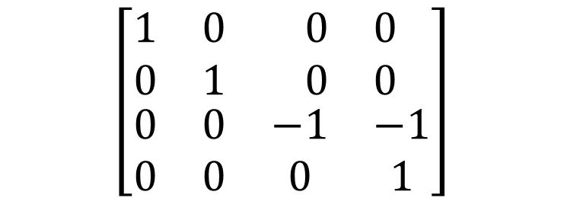
GLMatrix ortho matrix
ortho(left,right,bottom,top,near,far)
Imagine the eye is at (0,0,0) We look down the –z axis
The view volume is: [left, right] =[-1, 1] [bottom, top]=[-1, 1]
near =0
far =2
$$\left[\begin{matrix}\begin{matrix}1 & 0 \\ 0 & 1\end{matrix} & \begin{matrix}0 & 0 \\ 0 & 0\end{matrix} \\ \begin{matrix}0 & 0 \\ 0 & 0\end{matrix} & \begin{matrix}−1 & −1 \\ 0 & 1\end{matrix}\end{matrix}\right]$$

Slide 18
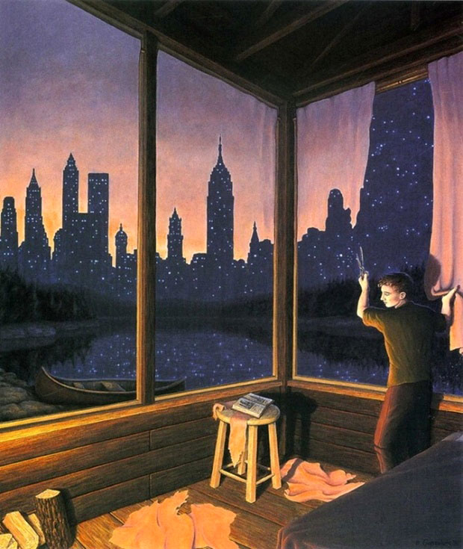
Perspective
Brain depends on shape constancy
Real world objects do not resize
Change in size due to depth
Closer objects larger
Farther objects smaller

Slide 19
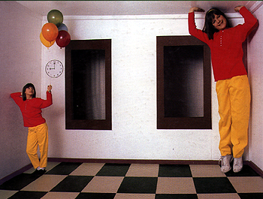
Ames Distorting Room

Slide 20
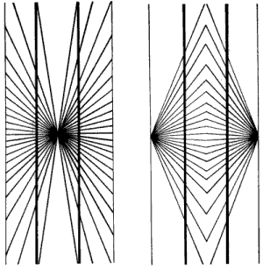
Hering Illusion

Slide 23
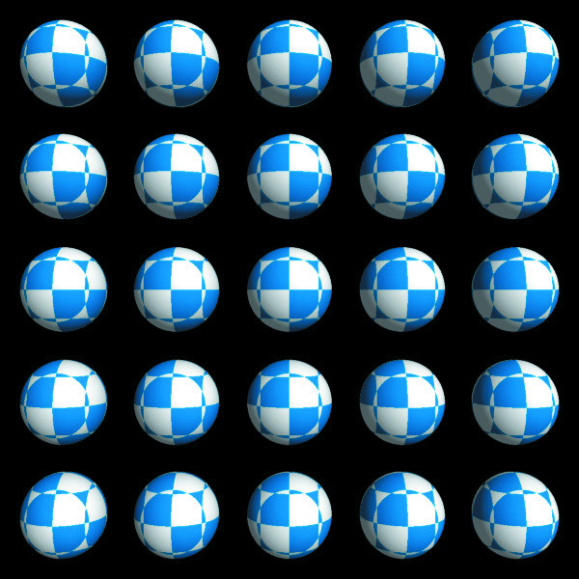

Perspective Distortion
Orthographic
Perspective
Should the spheres look like this? Why don’t our eyes see like this?
Notes:
Somce question

Slide 24
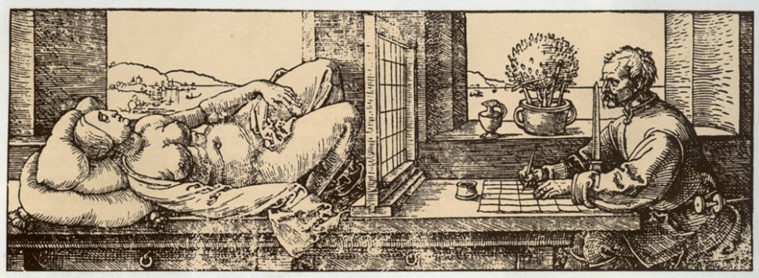
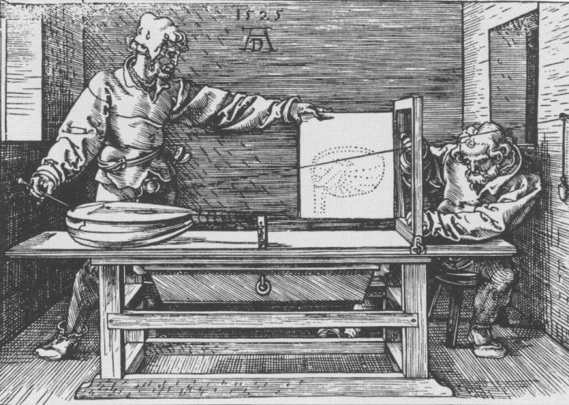
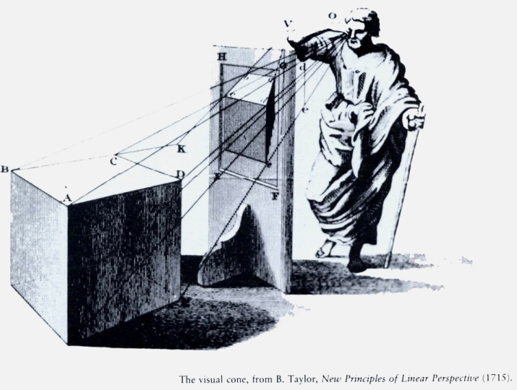
Perspective Projection
Albrecht Durer woodcut c. 1525, swiped from Marc Levoy’s CS48N notes c. 2007
Brain depends on shape constancy
Real world objects do not resize
Change in size due to depth
Closer objects larger
Farther objects smaller
How large, how small?
More Durer, swiped from Fredo Durand’s Art of Depiction
?

Slide 25
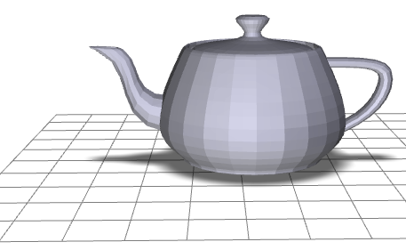
Perspective
screen
y
y_{view}
y_{clip}
-z
z_{view}
d
Eye is at origin (0,0,0)
Screen is distance d from the eye.
Looking down negative z-axis.
The two triangles are similar (two angles are obviously congruent)
This means corresponding sides are in the same proportions

Slide 26
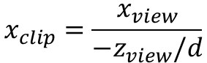
Perspective
screen
x
x_{view}
x_{clip}
-z
z_{view}
d
Same process derives the projection for the x coordinate.
What is z_{clip}?
$$x_{clip}=\frac{x_{view}}{{−z}_{view}/d}$$

Slide 27
Perspective
screen
x
x_{view}
x_{clip}
-z
z_{view}
d
This transformation is not invertible
It does preserve lines (except when?)
It is not an affine transformation (it does not preserve ratios of distances

Slide 28
Projections Using Homogeneous Coordinates
We can extend our use of homogenous coordinates to handle projections
Let the fourth homogeneous coordinate be any non-zero value w
To find the point it corresponds to:
multiply all four coordinates by 1/w
When homogeneous coordinate is zero
Denotes a “point” at infinity
Represents a vector instead of a point
Not affected by translation

Slide 29
Perspective
screen
y
y_{view}
y_{clip}
-z
z_{view}
d
By allowing w to change we represent more kinds of transformations

Slide 30
Distance
screen
y
y_{view}
y_{clip}
y'_{clip}
-z
z_{view}
d’
d
y_{clip} = d y_{view}/(-z_{view})
y'_{clip} = d’ y_{view}/(-z_{view}) = (d’/d) y_{clip}
Changing parameter d just changes scale of projection
Using d
Using d’

Slide 31
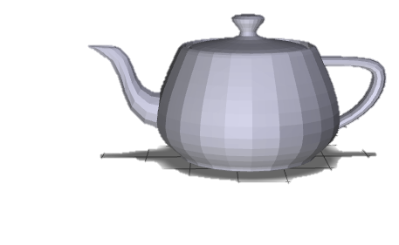
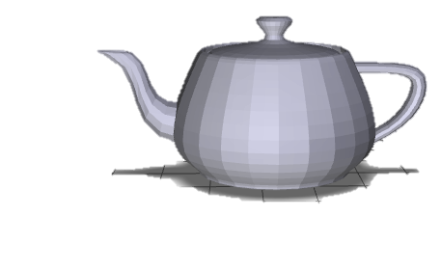
Perspective Distortion and Distance
screen
screen
y
y_{view}
y'_{clip}
y_{clip}
-z
z_{view}
d’
d
To change degree of perspective distortion, need to change distance from eye to scene,
…by moving scene closer or farther to eye,
… along z axis in viewing coordinates

Slide 32
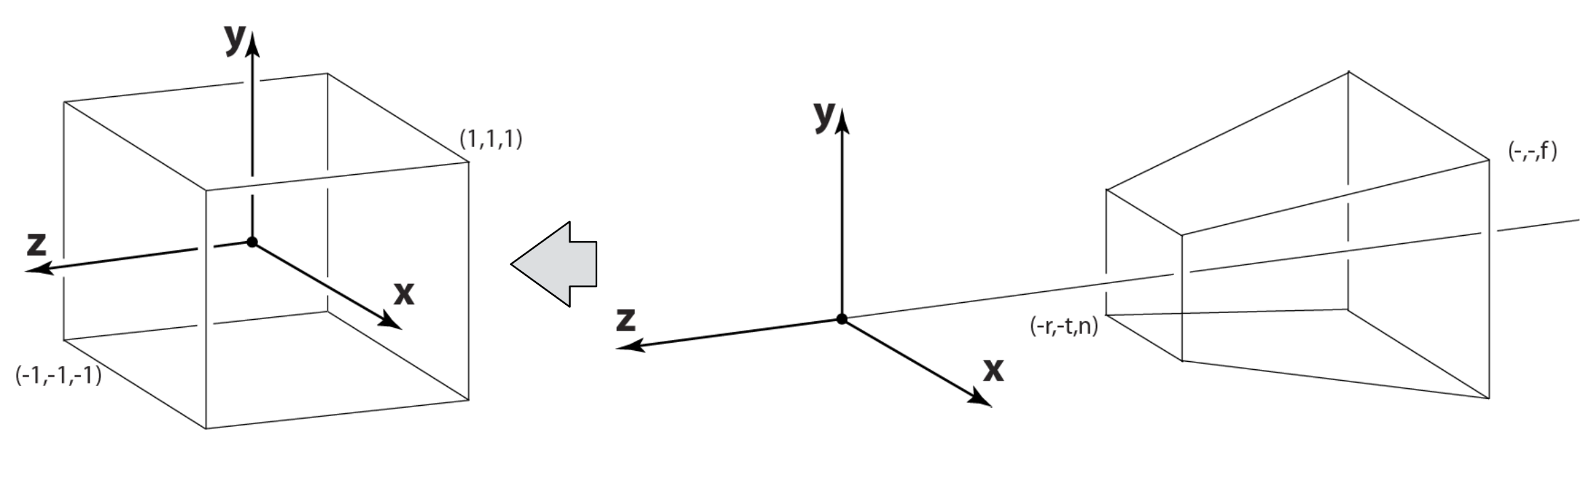
Perspective Projection in WebGL
Just like with parallel viewing we will
Define a viewing volume
Construct a normalization transformation
We turn a perspective projection into orthogonal projection
This allows us to use the built-in orthogonal projection in WebGL

Slide 33
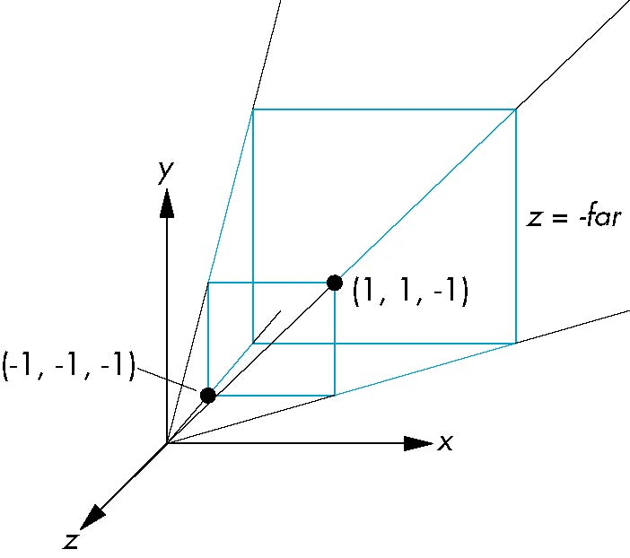
Perspective Normalization
Consider a simple perspective with
the COP at the origin,
the near clipping plane at z = -1, and
a 90 degree field of view determined by the planes x = ±z, y = ±z

Slide 34
Perspective Matrices
Simple projection matrix in homogeneous coordinates
Note that this matrix is independent of the far clipping plane
M =

Slide 35
Generalization
after perspective division, the point (x, y, z, 1) goes to
N =
x’ = -x/z
y’ = -y/z
z’ = -(α+β/z)

Slide 36
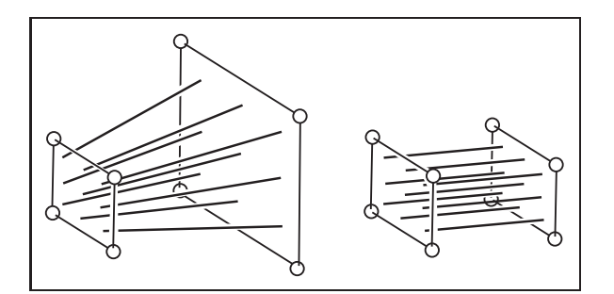
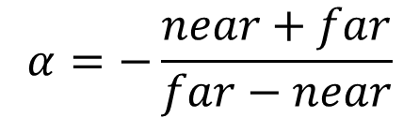
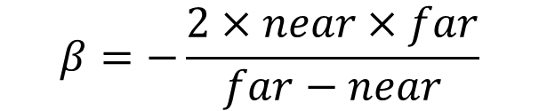
Picking α and β
If we pick
$$α=−\frac{near+far}{far−near}$$
$$β=−\frac{2×near×far}{far−near}$$
the near plane is mapped to z = -1
the far plane is mapped to z = 1
the sides are mapped to x = ± 1, y = ± 1
The new view volume is the default clipping volume

Slide 37
Projection and Hidden-Surface Removal
For two points p₁ and p₂, if z₁ > z₂ in the original clipping volume then for the transformed points z₁’ > z₂’
We can use z’ for hidden surface removal using depth comparison
The formula z’ = -(α+β/z) implies that the distances are distorted by the normalization
This can cause numerical problems especially if the near distance is small

Slide 38
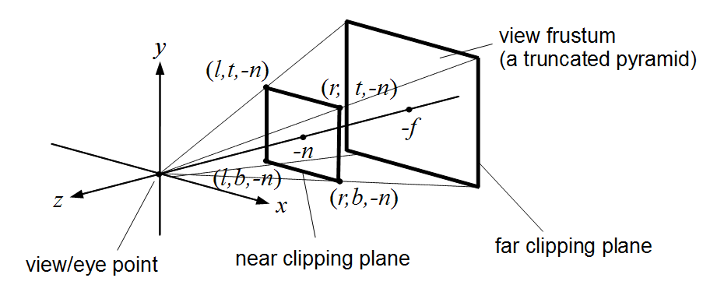
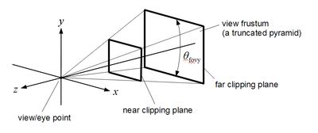
WebGL Perspective
mat4.frustum allows for an asymmetric viewing frustum using left, right, bottom, top, near, far
mat4.perspective generates a symmetric frustum using fovy, aspect, near, far fovy → vertical viewing angle in radians
aspect → aspect ratio of the viewport
near → distance from center of projection to near clip plane
far → distance from center of projection to far clip plane it computes a frustum with right=top x aspect top = near x tan(fovy/2) left = -right and bottom = -top

Slide 39
Perspective Matrices from glMatrix
frustum
perspective

Slide 40
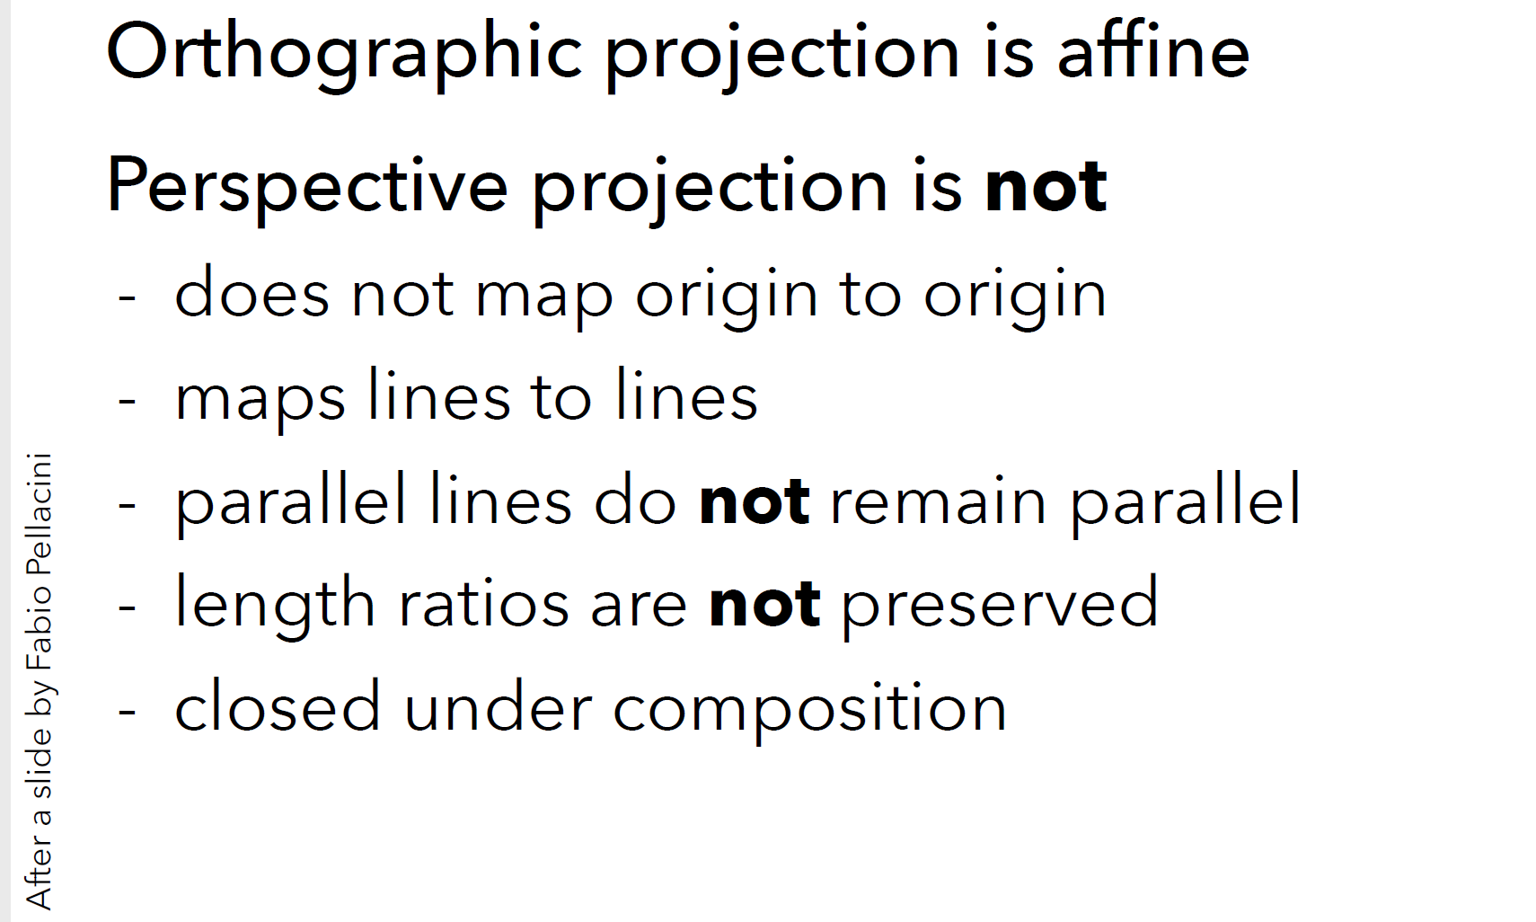
Projection Matrices

Slide 41
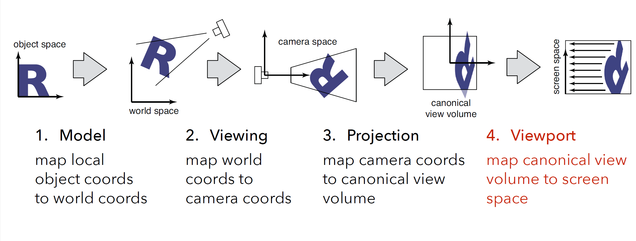
Chain of Transformations
Entire chain of transformation can be encoded as a single 4x4 matrix

